Slide 1
Data Analysis of Breweries and Beer
Andre Mauldin, Lijju Mathew, Michael Olheiser
June 26th, 2020

Slide 2
Outline
Breweries by State
Handling Missing Values
ABV and IBU by State
Highest ABV and IBU Beers
Distribution of ABV
Relationship between ABV and IBU

Slide 3
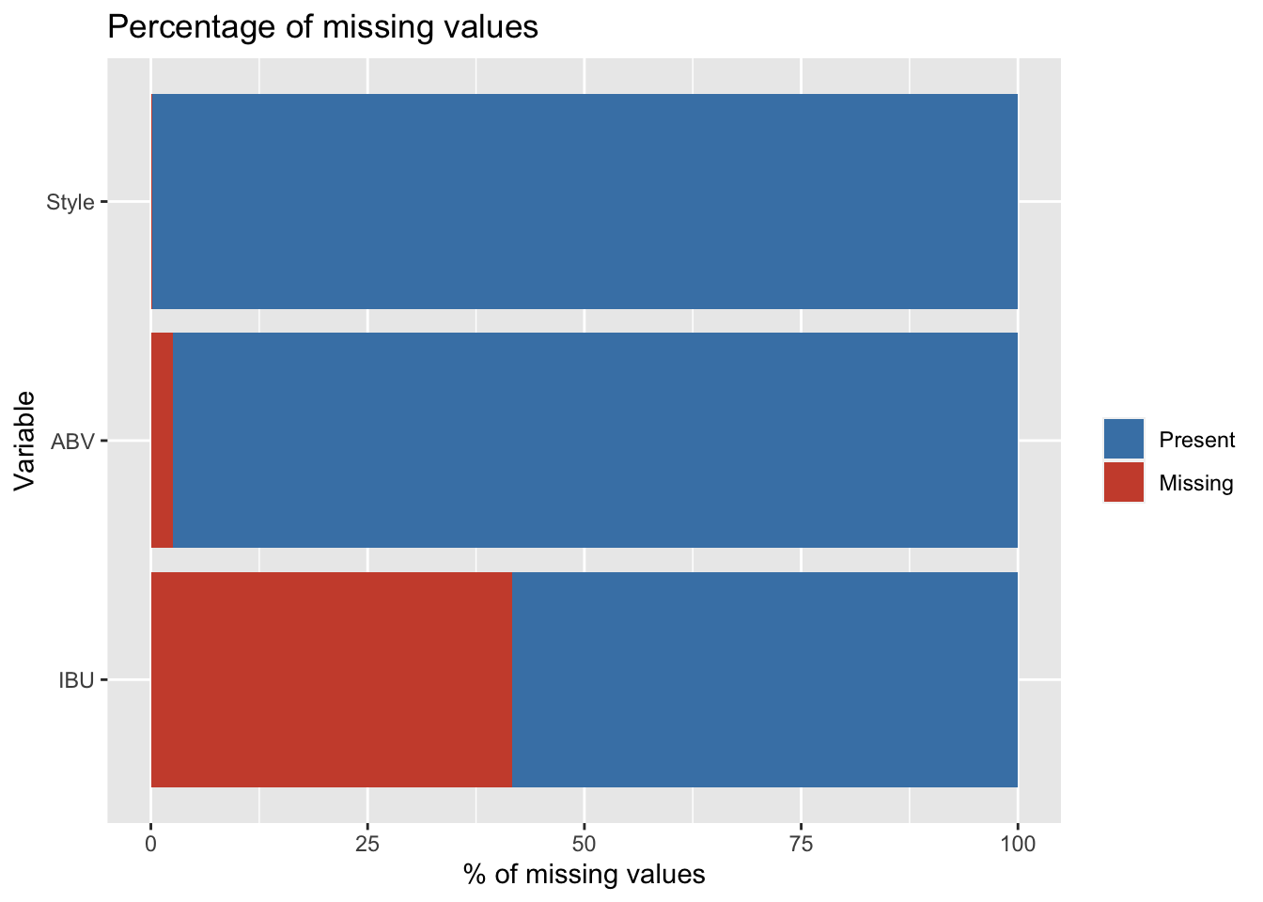
Handling Missing Values
IBU is not regularly reported per beer
Replace missing values with average IBU/ABV in that style
9 styles of beer do not contain any reported IBUs including 37 Ciders
Set IBU to zero for Cider. Drop remaining styles with no IBUs.
Result: Drops 20 beers out of 2410.

Slide 4
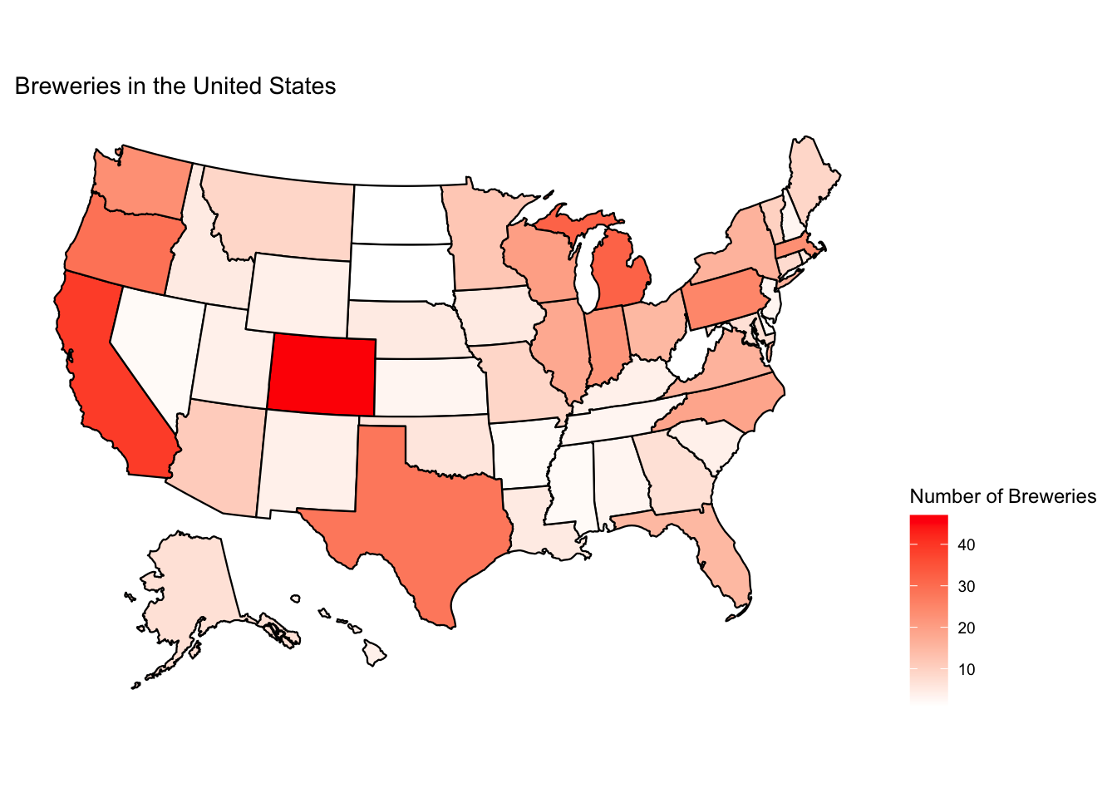
Distribution of Breweries across the United States
California, Colorado, Michigan contain the most breweries in the US
No specific region that is dominated by breweries
Population is not the only factor affecting the presence of breweries

Slide 5
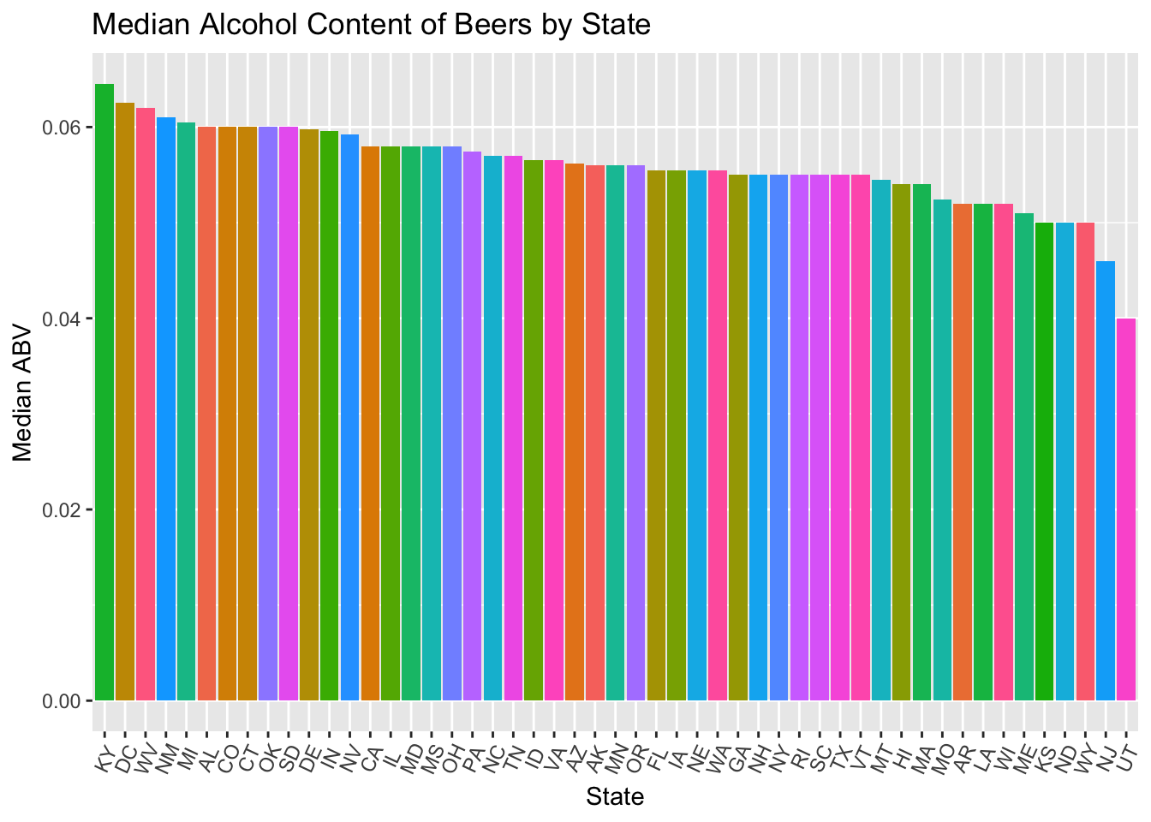
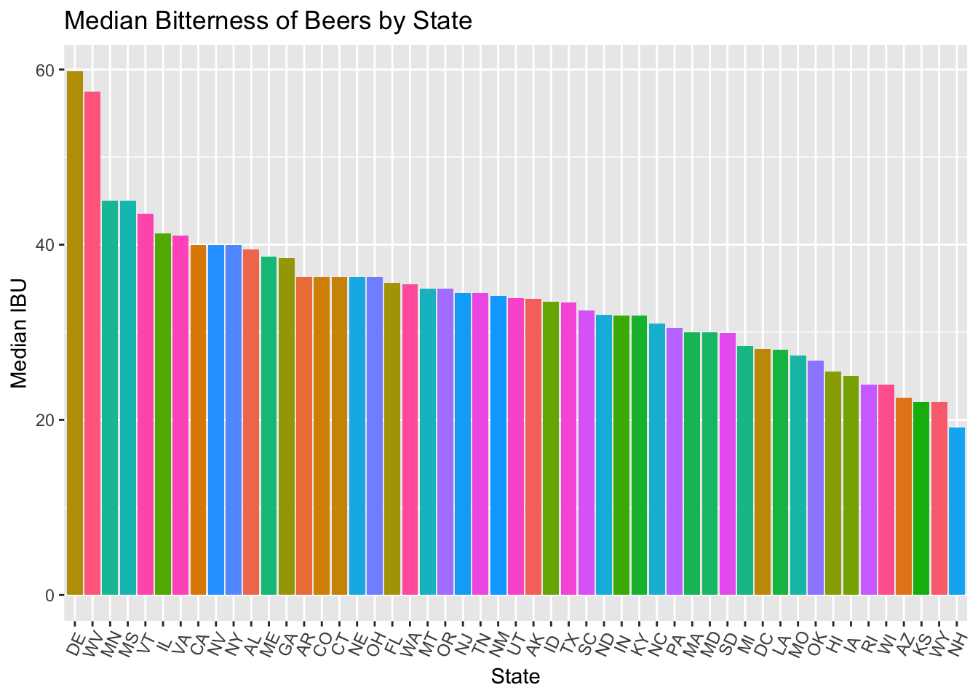
Median IBU and ABV by State
Median ABV varies less across states than median IBU
No obvious geographical/regional pattern.
A higher Median ABV does not necessarily indicate higher ABV ( see next slide)

Slide 6
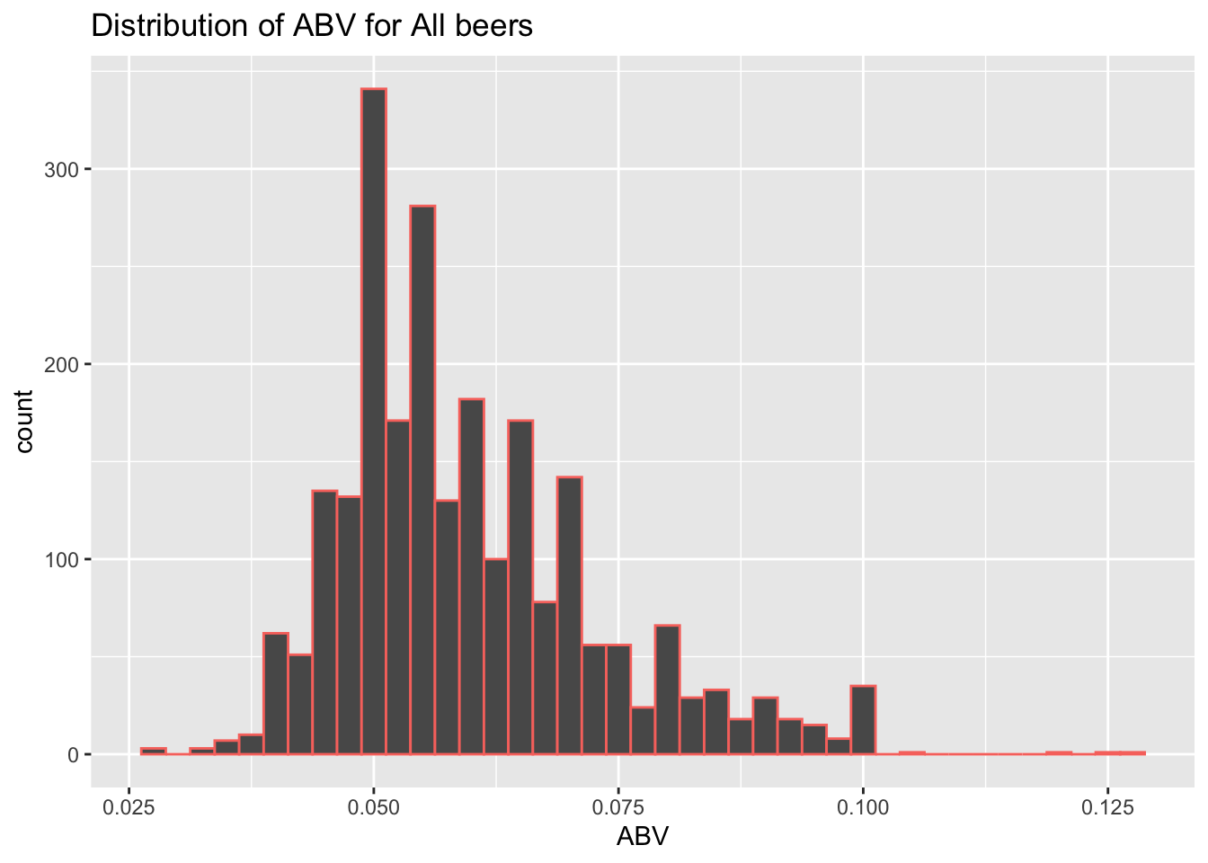
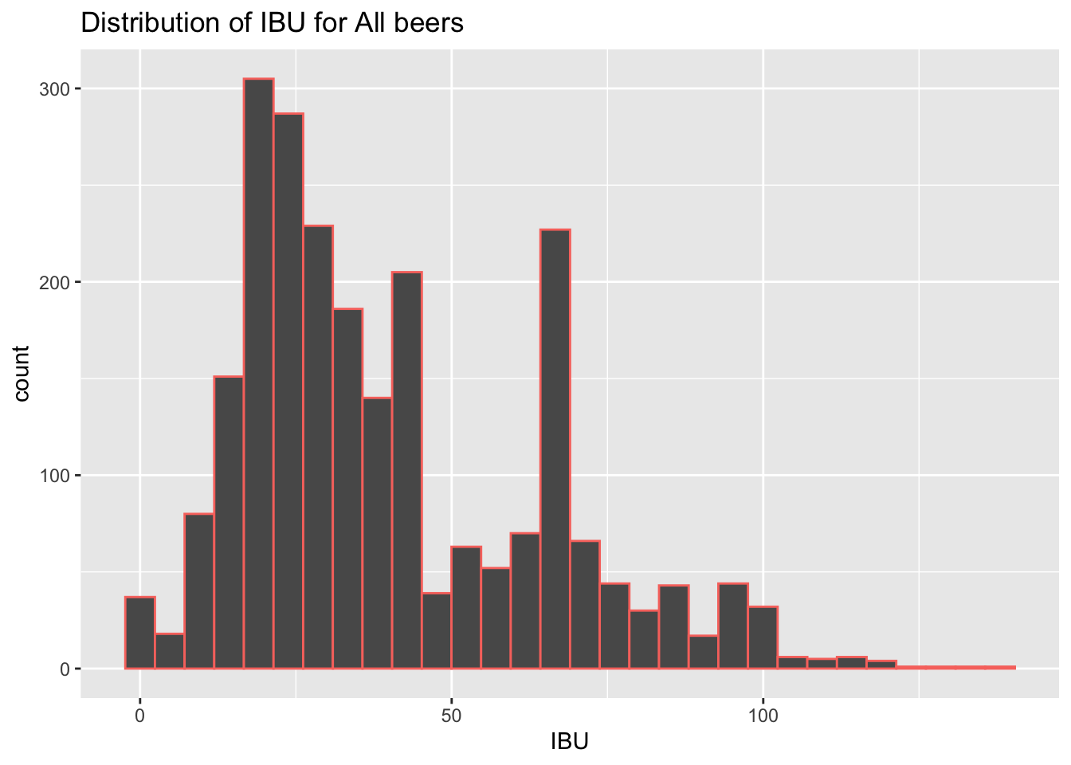
Distribution of Alcoholic Content of Beers
Median = 0.05600
Mean = 0.05974
Distribution is slightly right-skewed as beers are not typically strong alcoholic drinks.
Median = 33.81
Mean = 40.27
Distribution may be bi-modal.

Slide 7
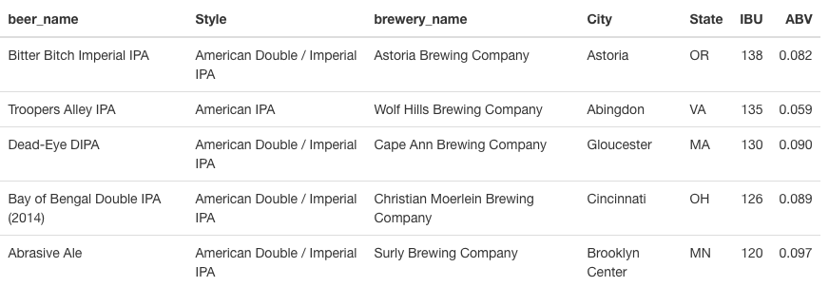
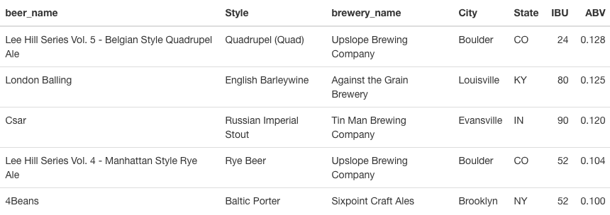
Top IBU and ABV Beers in the US
Top 5 IBU Beers
Boulder, CO has 2 of the top 5 IBU beers
Top 5 IBU beers are all American IPAs
Top 5 ABV Beers

Slide 8
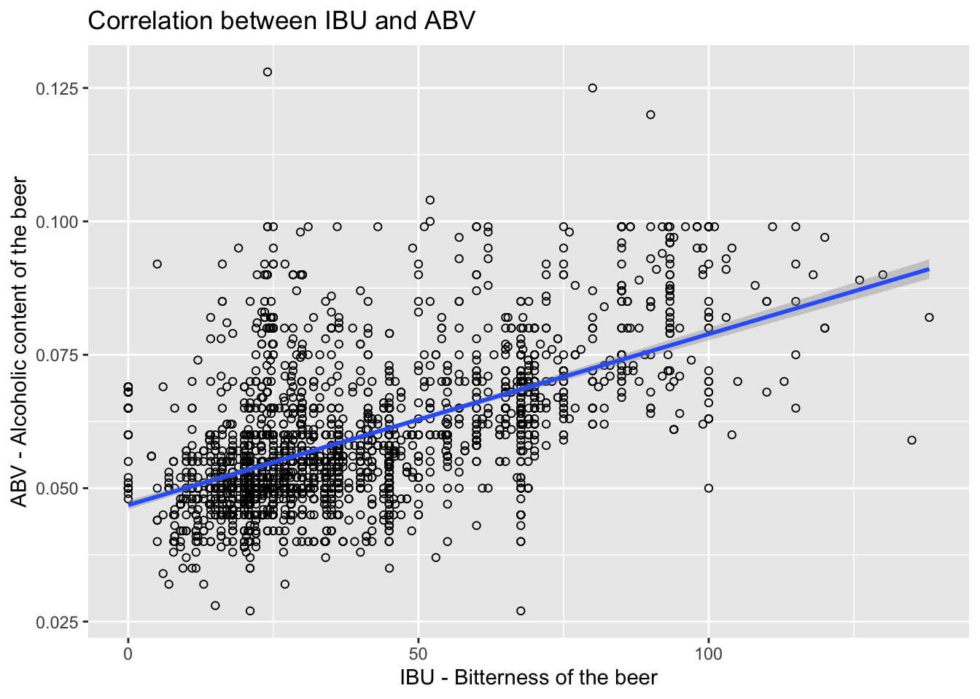
Relationship between IBU and ABV
Positive correlation
Correlation value = 0.58
95% CI (0.55 , 0.61)
Data is sparse beyond ~60 IBU.
There is not strong evidence against equal variances indicating a linear regression may be an appropriate model here.

Slide 9
Conclusion
Key takeaways
No obvious regional patterns in the US of brewery locations
IBU not regularly reported
Positive linear relationship between IBU and ABV
Bi-modal distribution of IBU – possibly different markets?
Further research
Classifcations of beer based on IBU/ABV
Distribution/Sales data – where is the beer going?
Demographics, economics of states

